Slide 1

Flexible AC Transmission Credit Hours = 3 by Dr. Wazir Muhammad Laghari Lecturer Email: wazirlaghari@buetk.edu.pk
Electrical Engineering Department
Balochistan University of Engineering and Technology
Khuzdar

Slide 2
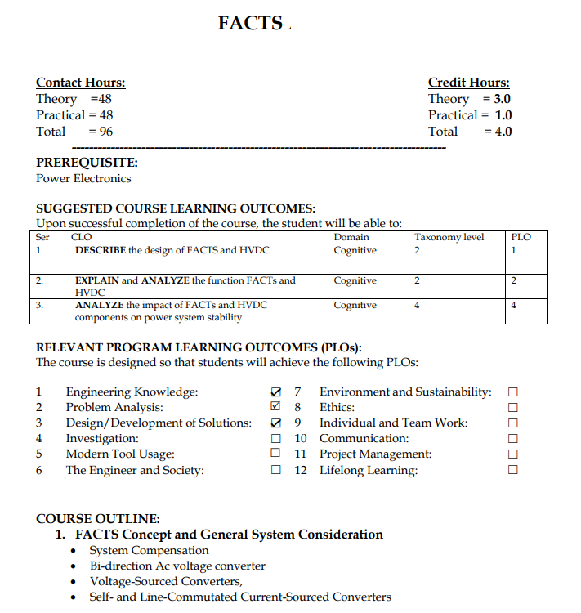
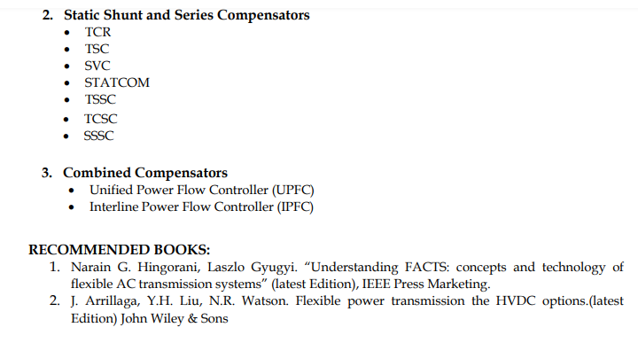

Slide 3
Lecture Tentative Plan
Lecture No | Description
Lecture: 01 | Introduction to FACTS: FACTS: Concept, power flow and stability, basic theory of line compensation, Thyristor controlled and converter-based FACTS controller.
Lecture: 02 | Power Electronic Controllers: Review of PWM voltage source inverters used in FACTS; Multi-level inverters, cascaded multilevel inverters
Lecture: 03 | Static Shunt Compensators: Midpoint voltage regulation; Variable impedance type and switching converter type static Var generators, SVC and STATCOM – TCR, TSC, V-I and V-Q characteristics, system stability.
Lecture: 04 | Static Series Compensators: Concept of series compensation, voltage stability, variable impedance type series compensators, GCSC, TSSC, TCSC and SSSC, control techniques, control range and VA rating.
Lecture: 05 | Static Voltage and Phase Angle Regulators: Power flow control, TCVR and TCPAR, improvement of transient stability.
Lecture: 06 | Unified Power Flow Controller (UPFC): Concept of power flow control, operation and control of UPFC, Interline Power Flow Controller
Lecture: 07 | Stability Analysis: Modeling of FACTS devices, optimization of FACTS, transient and dynamic stability enhancement.
Lecture: 08 | Applications: Principle of control of FACTS in HVDC links, coordination of FACTS devices with HVDC links

Slide 4
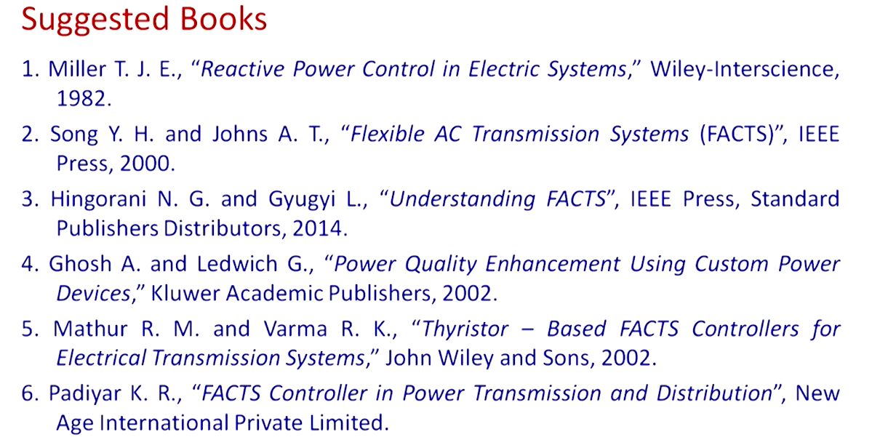

Slide 5
Lecture-01
Introduction to Flexible AC Transmission

Slide 6
Introduction to FACTS
FACTS = Flexible Alternating Current Transmission Systems.
FACTS is a generally power electronics-based system.
FACTS is a collection of controllers (Electronic Controller not mechanical Controller).
FACTS Controller controls series impedance, shunt impedance, current, voltage, phase angle etc.
Transmission line involve the combination of mechanical and FACTS controller.
High power transistor or thyristor is the basic element of power electronics.

Slide 7
History or Origin of FACTS
Oil Embargo of 1974 and 1979.
Environmental Movement.
Magnetic Field Concerns.
Permit to build new transmission lines.
HVDC and SVCs.
EPRI FACTS Initiative (1988).
Increase AC Power Transfer (GE and DDE Papers).
The Need for Power semiconductors.

Slide 8
Background and Issues
Why we need transmission interconnection
Pool power plants and load centers to minimize generation cost
Important in a deregulated environment
Opportunities for FACTS
Increase power transfer capacity.
SVC (Nebraska GE 1974, Minnessota Westinghouse 1975, Brazil Siemns 1985).
TCSC, UPFC AEP 1999.
Trends
Generation is not being built.
Power sales/purchases are being made in open market.

Slide 9
Power System Facing Problem of Peak Power Management
For the few decades, this power system is facing a problem of the peak power management.
For ever increasing the load demand, we required to put a new transmission line and generation system.
However for the small or due to small durations of the peak hours, it is not economically feasible to put a new line and for this we want a power handling capabilities of the transmission line required to be increased in the peak time.
So FACTS devices gives you the potential to increase control and provide stability to power system.

Slide 10
System Architectures and Limitations
Post contingency: It is the state of the power system after a contingency has occurred.
A contingency is the loss or failure of a small part of the power system (e.g. a transmission line), or the loss/failure of individual equipment such as a generator or transformer.
LOOP FLOW
Unscheduled power flow on transmission line and result in a violation of reliability criteria and decrease the available transfer capability.
System Architecture
Radial, interconnected areas, complex network.
Power Flow in AC System
Power Flow in Parallel and Meshed Paths.
Transmission Limitations
Steady-State (angular stability, thermal limits, voltage limits).
Stability issues (transient, dynamic, voltage and SSR (Solid State Relay as a switch).
System issues (Post contingency conditions, loop flows, short-circuit levels).
Dynamic stability is also issue when load changes occurs. It can be defined as the energy balance between the supplied power and the consumed power at a given point.
These points keeping in mind when designing the FCATS Devices

Slide 11
Benefits of FACTS
FACTS devices possess following attributes:
Provide dynamic reactive power support.
Voltage control.
Improve system stability.
Control real and reactive power flow.
Reducing power losses in transmission lines.
Improving voltage profile and less voltage fluctuations.
Steady state and transient stability limit is increased.
Provides congestion management.
Security of the system increased & reducing blackout chances.
Provide greater flexibility in expansion of existing transmission system.
FACTS helps to improve the power enhancement capability.
FACTS have high speed reliability of switching.

Slide 12
FACTS CONTROLLER
The FACTS controller is defined as a power electronic based system and other static equipment that provide control of one or more AC transmission system parameters.
FACTS controller controls series impedance, shunt impedance, current, voltage, phase angle etc.

Slide 13
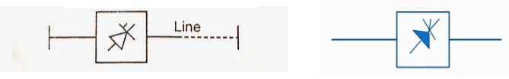
Classifications of FACTS Controllers
Generally FACTS devices can be classified as :-
Shunt Connected Controllers :- Inject Current
Series Connected Controllers :- Inject Voltage
Combined Series-Series Controllers
Combined Shunt – Series Controllers
Classification based on power electronic devices: -
Variable Impedance Type (VIT).
Voltage Sources Converter (VSC) Type
Figure: General symbol of FACTS Controller

Slide 14
Classifications of FACTS Controllers
Variable Impedance Type (VIT) Controllers include:-
SVC-Static Var Compensator- Shunt Connected
TCSC – Thyristor Controlled Series Compensator.- Series Connected
TCPST- Thyristor Controlled Phase Shifting Transformer- Combined Shunt & Series Connected.
Combined Series-Series Controllers
Combined Shunt – Series Controllers
Voltage Source Converter (VSC) Type Controllers include:-
STATCOM – Static Synchronous Compensator – Shunt Connected
SSSC – Static Synchronous Series Compensator – Series Connected.
IPFC- Interline Power Flow Controller – Combined Series-Series Connected.
UPFC – Unified Power Flow Controller – Combined Shunt- Series Connected.
Any device used to compensate for something, notably to achieve a better balance is known as Compensator.
Suppose one quantity is more than we add another opposite quantity to reduce the affect of other or balance it.
In power system if reactive power amount is more than voltage drop increase than losses increase, so we can absorb the reactive power

Slide 15
Lecture No: 03 Power Flow Equation

Slide 16
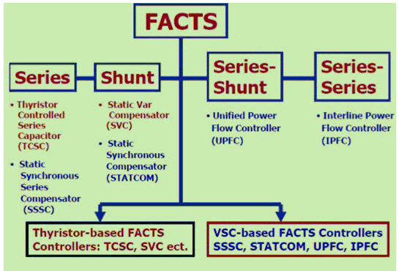
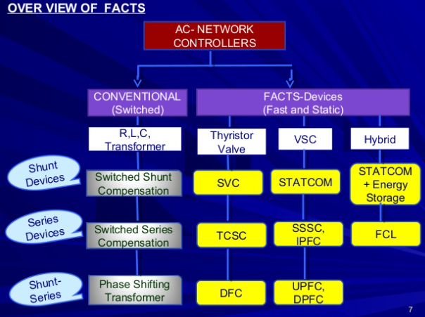
Broad Classification of FACTS Controllers / Compensator

Slide 17
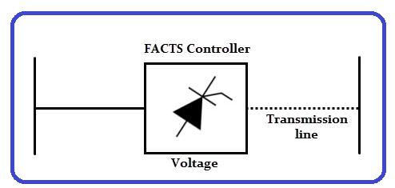
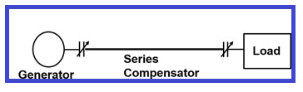
Series Controllers
It is connected in series with transmission line.
The series controller could be a variable impedance or variable source.
All series controllers inject voltage in series with the line.
Series Controllers consist of capacitors or reactors which introduce voltage in series with the line.
They supply or consume variable reactive power.
Examples of series controllers are SSSC (Static Synchronous Series Compensator) , TCSR, TCSC (Thyristor Controlled Series Capacitor), TSSC, IPFC, etc.

Slide 18
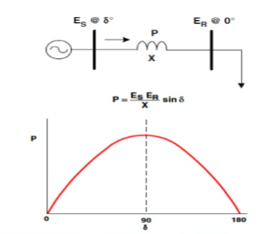

Slide 19
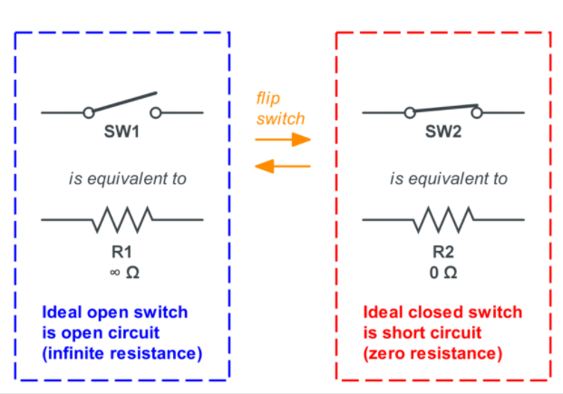
Switch
A switch has two states: either the two nodes can be connected or disconnected.
In an ideal switch, the connected state behaves like a resistor R=0 (short circuit), while the disconnected state behaves like a resistor R=∞ (open circuit):

Slide 20
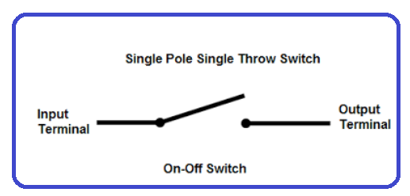
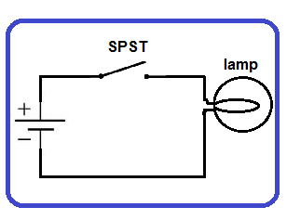
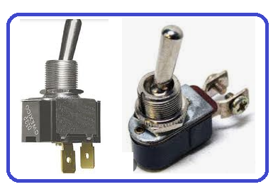
Single-Pole Single-Throw (SPST) Switch
The switch shown below is a “single throw” switch, meaning the switchable terminal can either be connected or not. Overall, this is called a SPST switch, for Single-Pole Single-Throw. This is useful as a simple on-off switch, like most light switches you’re familiar with.

Slide 21
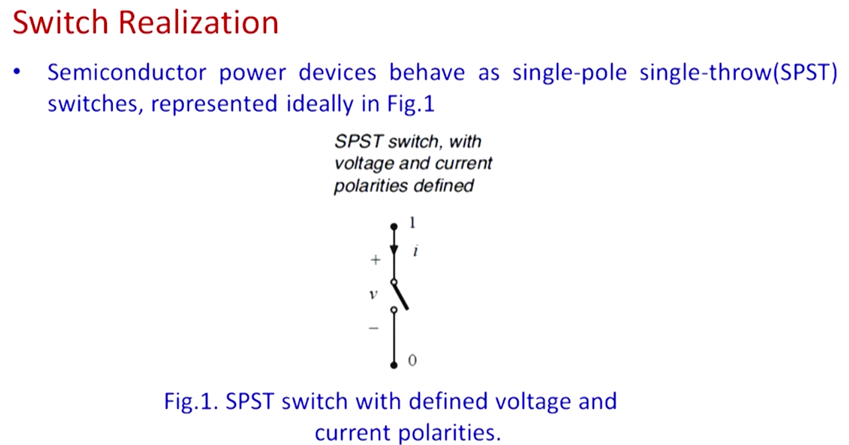

Slide 22
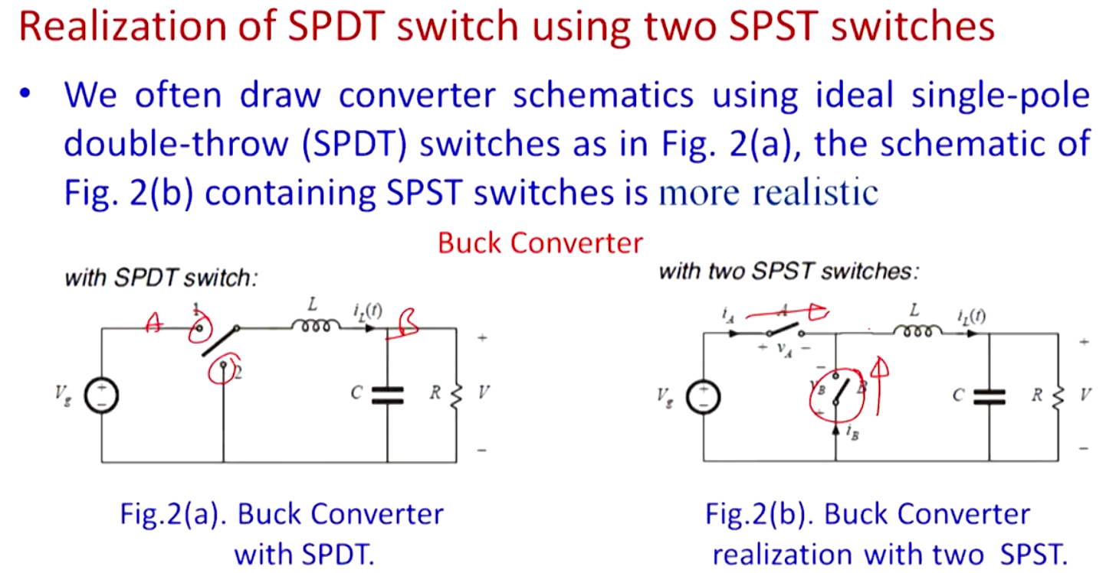

Slide 23
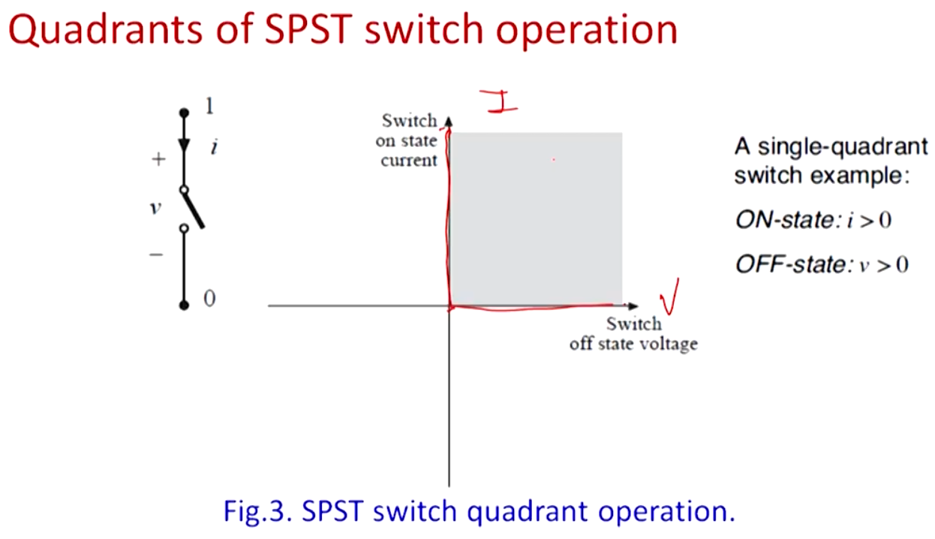

Slide 24
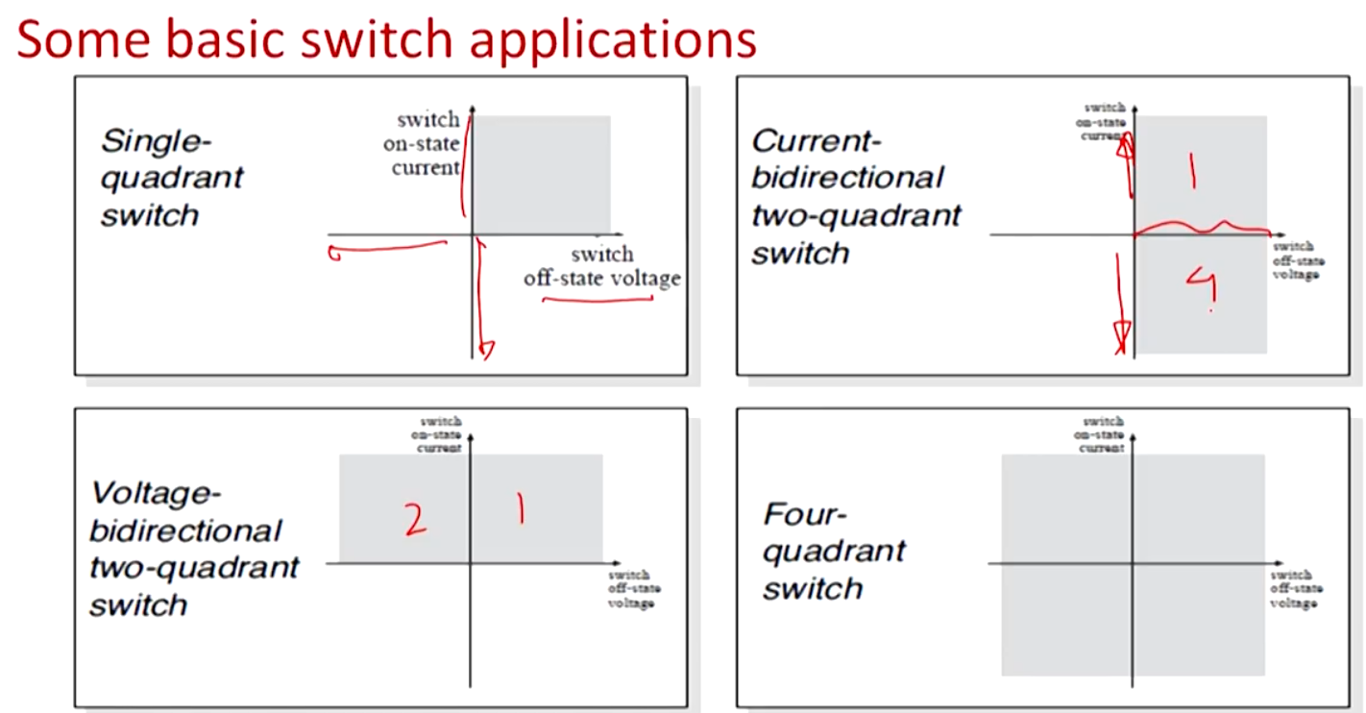

Slide 25
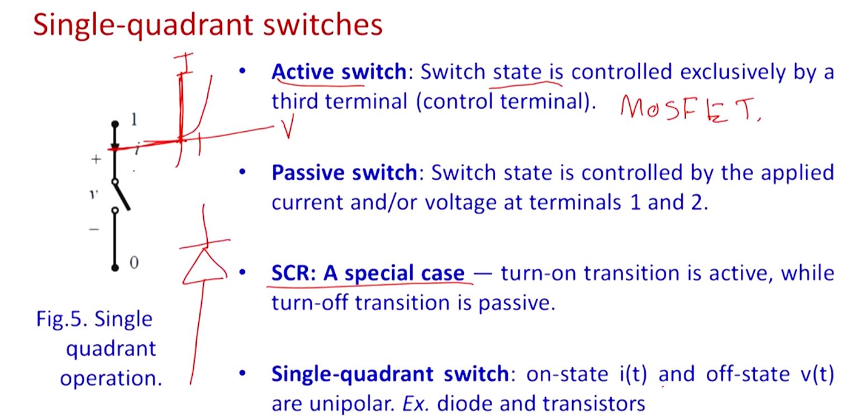

Slide 26
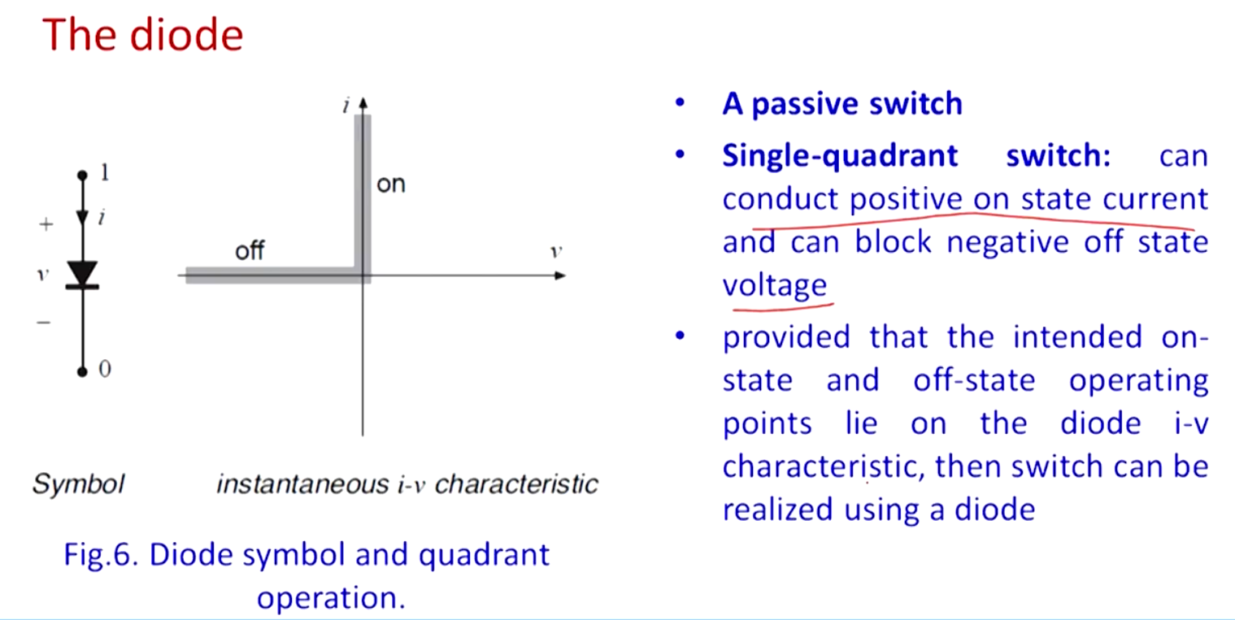

Slide 27
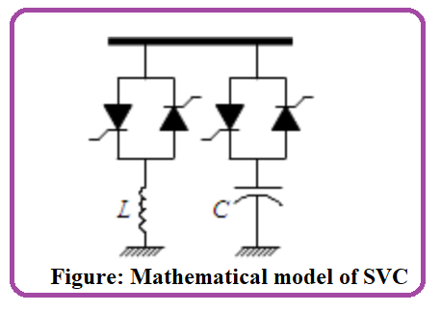
SVC- Static VAR Compensator
SVC is FACT device, which is used as Capacitor compensator and Inductive compensator.
It is a shunt type controller.
It is used to control the power flow in transmission lines.
It also improve the transient stability.
If a power system having a low voltage than it generate a reactive power through L branch.
If a power system having a high voltage than it absorbed a reactive power through C branch.

Slide 28
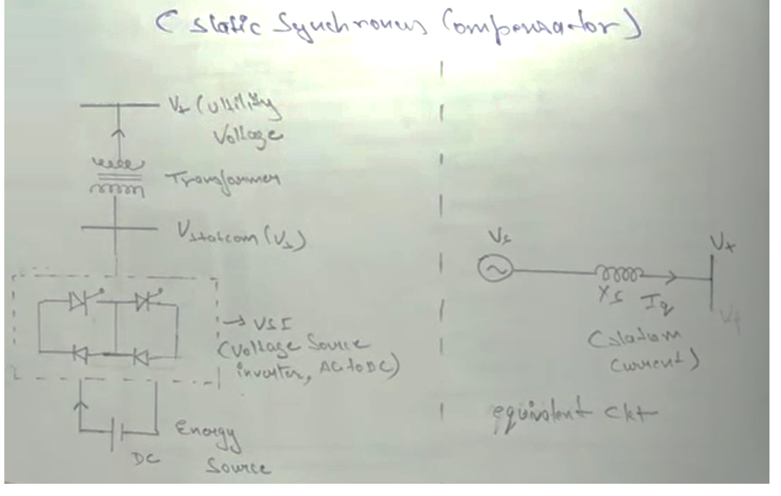
STATCOM – Static Synchronous Compensator
It is a basic circuit diagram of STATCOM.
Apply DC voltage source to Inverter and to change DC power to AC power.
AC power feed to Vstatcom.
Than go to Transformer and finally goes to the utility bus voltage.
So Statcom balance the low or high voltage and perform as compensator.
Equivalent circuit diagram:
First is a Statcom.
Than transmission line reactance.
And Vt is the bus voltage.
Statcom voltage > Bus voltage = reactive power generate or feed.
Statcom voltage < Bus voltage = reactive power absorb.

Slide 29
Electric power conversion
DC to DC | DC to AC | AC to DC | AC to AC
Linear regulator Voltage regulator Motor–generator Rotary converter Switched-mode power supply | Power inverter Motor–generator Rotary converter Switched-mode power supply | Rectifier Mains power supply unit (PSU) Motor–generator Rotary converter Switched-mode power supply | Transformer or autotransformer Voltage converter Voltage regulator Cycloconverter Variable-frequency transformer Motor–generator Rotary converter Switched-mode power supply

Slide 30
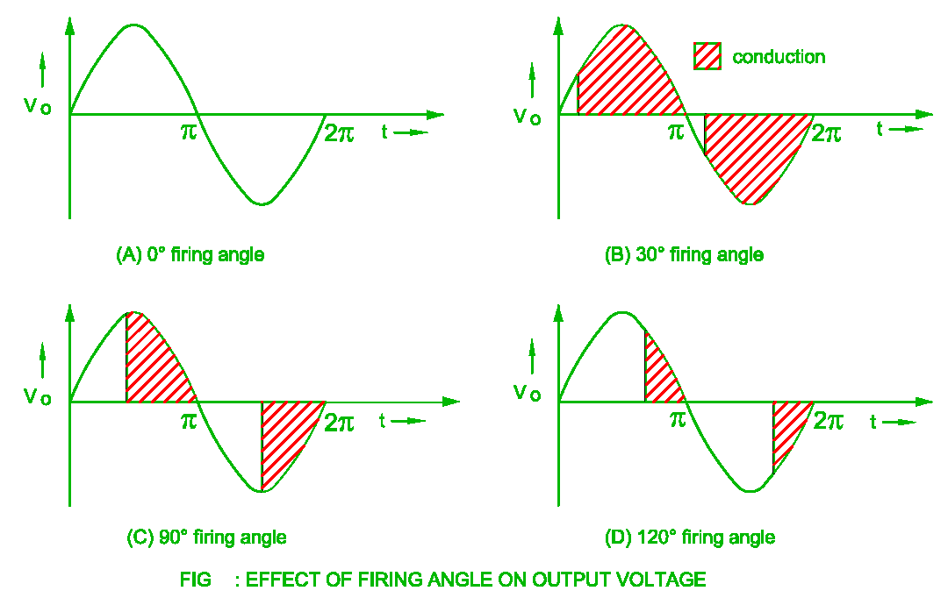
Firing Angle
The number of degrees from the beginning of the cycle when SCR is switched on is firing angle. Any SCR would start conducting at a particular point on the ac source voltage. Such specific point is defined as the firing angle

Slide 31
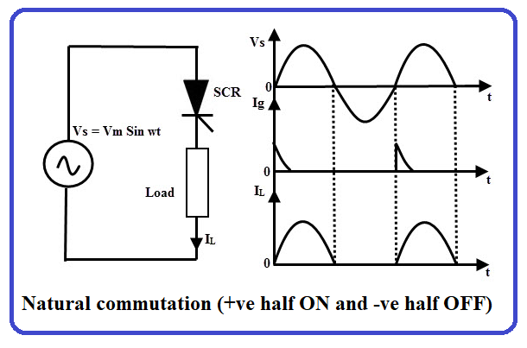
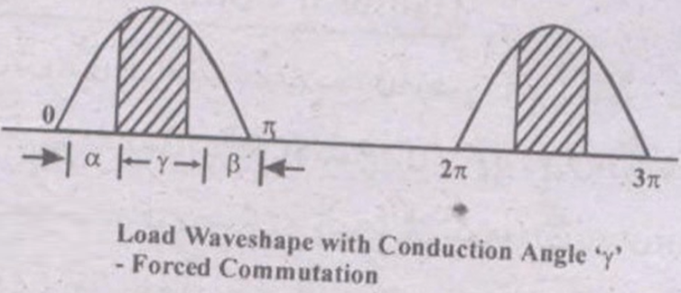
Commutation OR Commutation of SCR
It is the process to turning off the SCR or Thyristor is known as Commutation.
The transition of an SCR from forward conduction state to forward blocking state is called as turn OFF or commutation of SCR.
There are mainly two types of commutation:
(1) Natural Commutation (2) Forced Commutation
In such circuits, forward current must be forced to zero with an external circuit to commutate the SCR hence named as forced commutation.
SCR Forward bias = ON
SCR Reverse bias = OFF

Slide 32
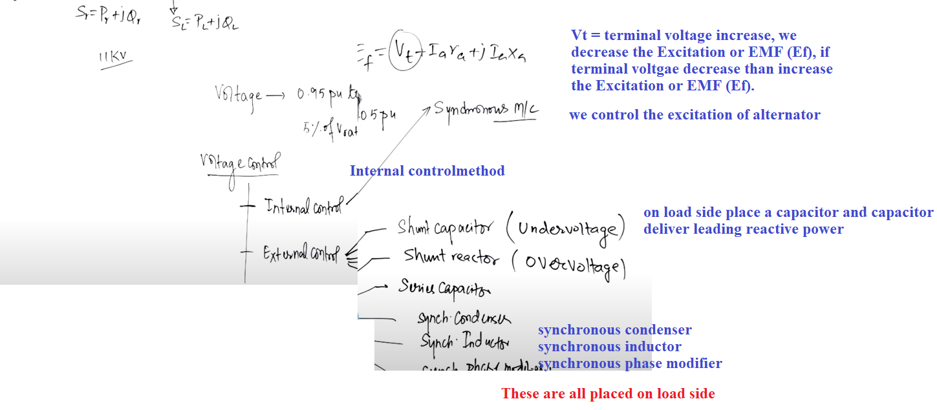
Voltage Control Compensation Technique
Shunt capacitor, shunt reactor and series capacitor are called static controller
Dynamic controller, because synchronous motor is used

